Slide 1
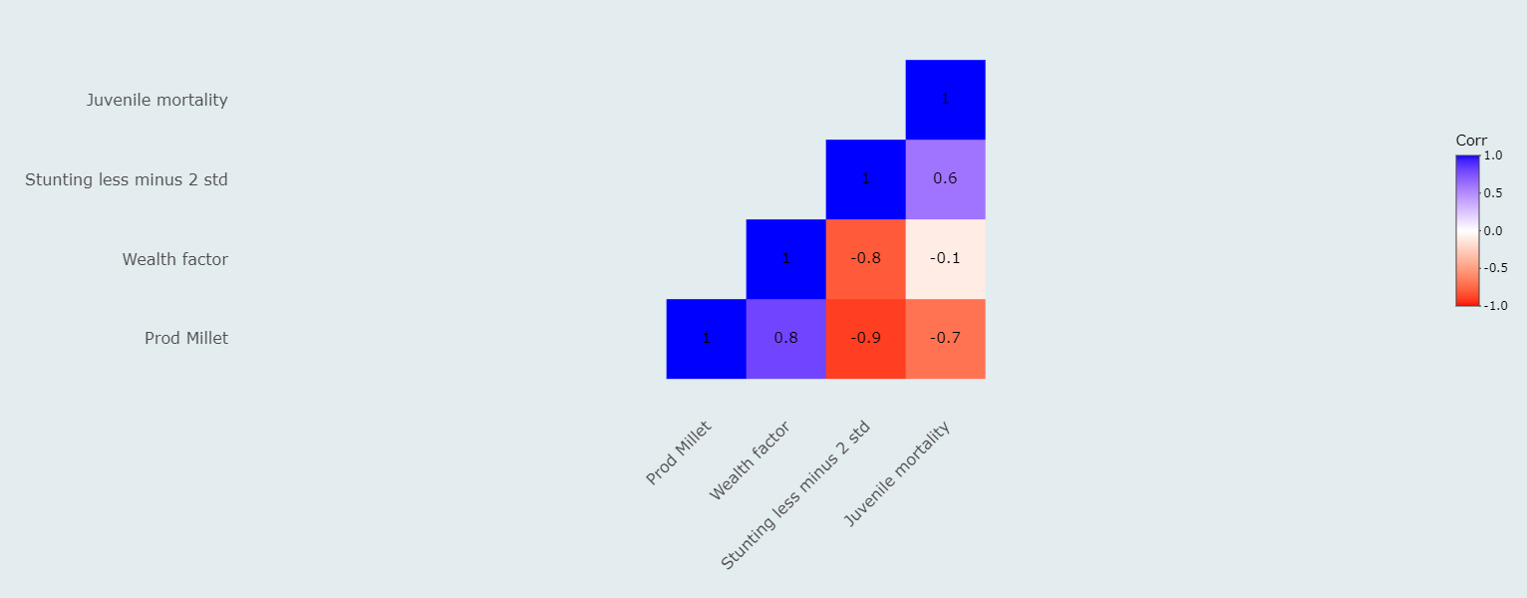

Slide 2
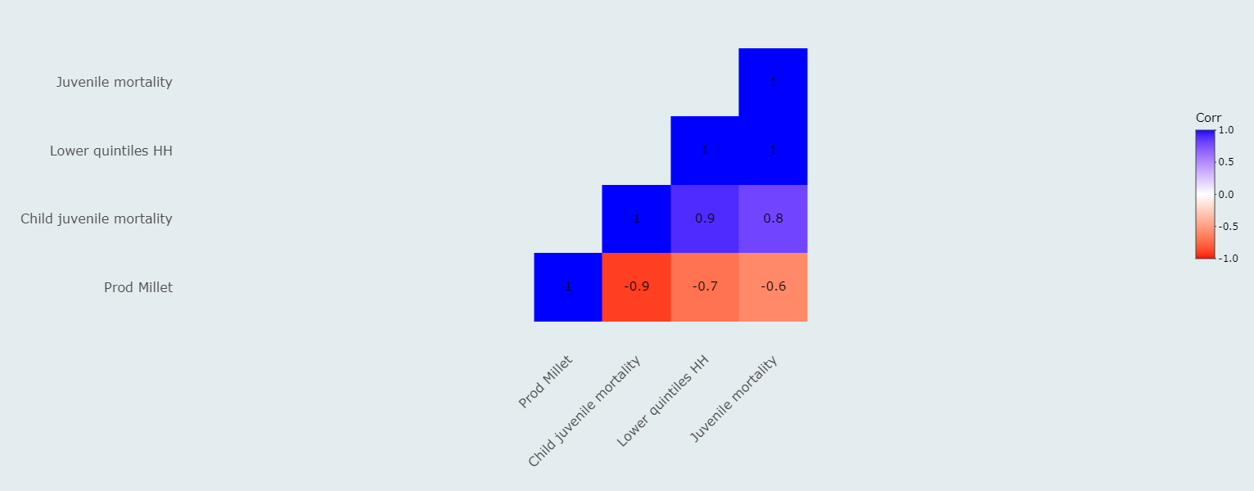

Slide 3



User selects:
Year;
Mean or sum;
Districts;
Variables;
Compare districts or years*;
Stack graph**;
Compare districts or variables***

